Slide 1
Group 6 Book Recommendation System
Group Members : Mr.Abhijit Shirish Kharade Mr. Rajiv ranjan Kumar Mr. Rohith Vaddeti Mr. Roger Barreto Mr. Tanveer Mubarak Shaikh Miss. Sakshi Rajendra Shirahatti

Slide 2
Contents:
Business Objective:
Data Summary
EDA/Data Cleaning
Recommendation Models
Collabrative Filtering
Recommendation Based on : 1) Book Name
2) Book Authors
3) Users Age
4) Country
Deployement

Slide 3
Business Objective :
Generate the features from the dataset and use them to recommend the books accordingly to the users.
Data Summay :
Books Dataset : Shape of Books Dataset : (271360, 8)
1) ISBN. 2) Year-Of-Publication.
3)Book-Title. 4) Publisher.
5)Book-Author 6)Image-URL-S.
7)Image-URL-M. 8)Image-URL-L
Ratings Dataset: Shape of Ratings Dataset : (1149780, 3)
1)User-Id 2) ISBN 3) Book-Rating
Users Dataset: Shape of Users Dataset : (278858, 3)
1) User-ID 2)Location 3)Age

Slide 4
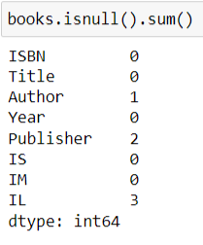
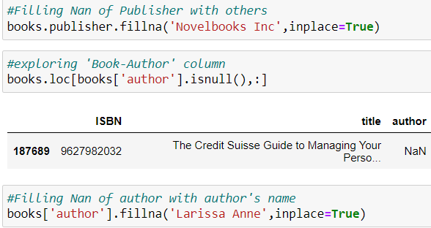
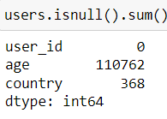
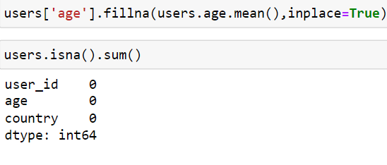
EDA:
Null value Imputation: Books Dataset
Users Dataset:
Replacing NAN Values with Publisher
Name and Author Name
Replacing NAN Values
with Mean

Slide 5
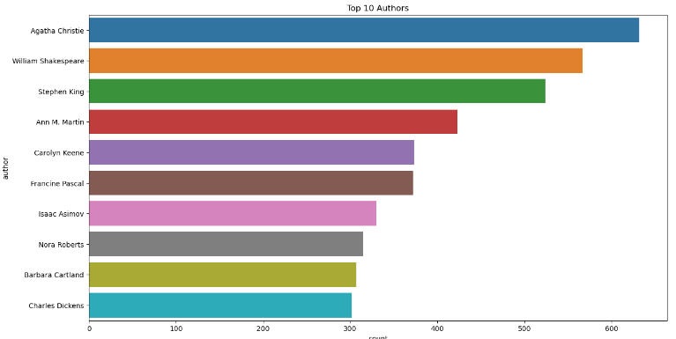
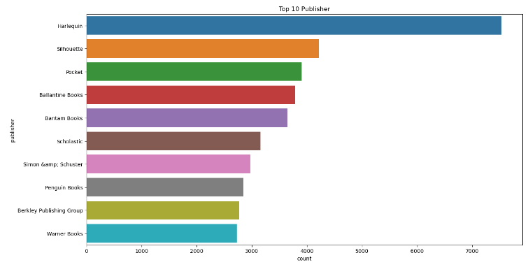
Visualization:
1) Books Dataset: Country with most number of Users
2) Top 10 Publishers :

Slide 6
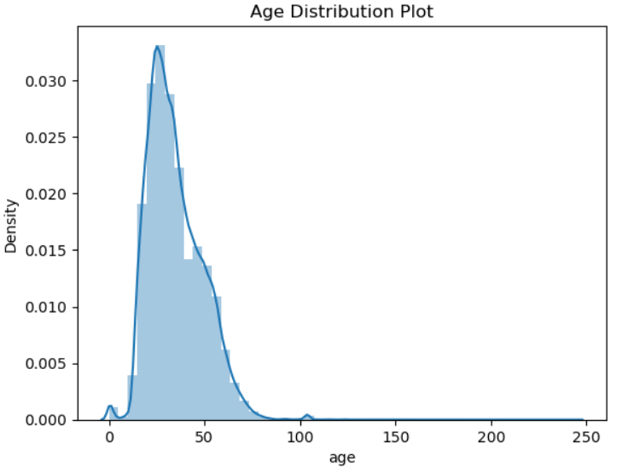
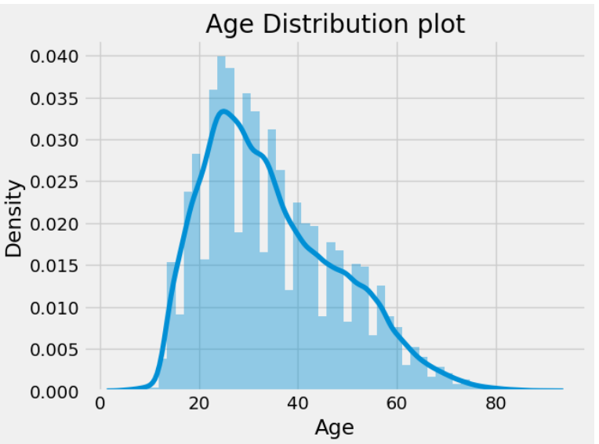
Users Dataset
1) Age Distribution Plot:
Here we can see the ages are '0' and '244'. we can take only reasonable age as shown in
age distribution plot from 5 to 80 ages.
Below 5 age and above 80 age all are outliers make
all outlires null and replace them with mean on base of country

Slide 7
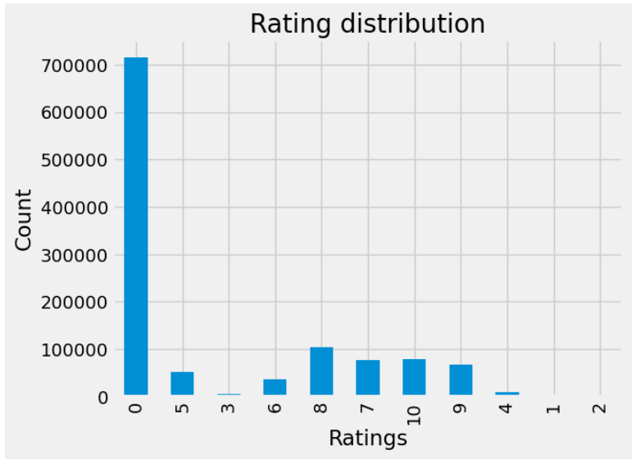
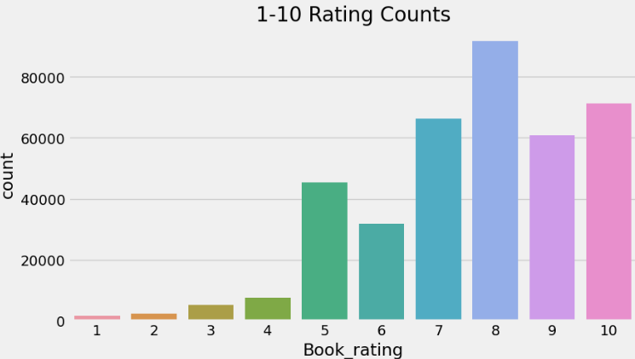
Ratings Dataset
1) Ratings Distribution from 0 to 10 : 2) Rating Counts from 1 to 10:

Slide 8
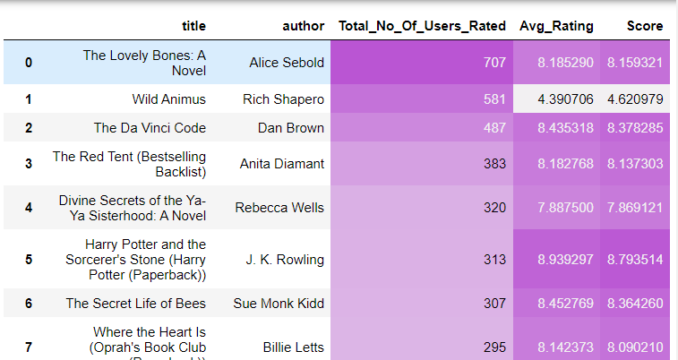
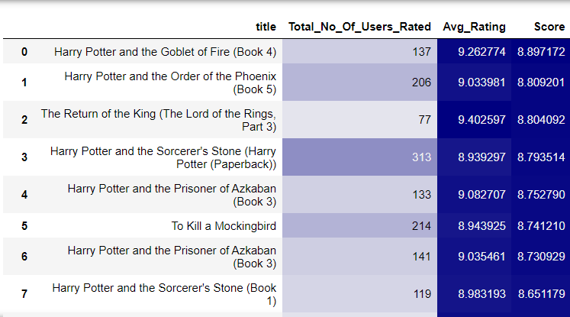
Recommendation Models:Popularity Based
1)Popular Books: 2) MostNumber of time Rated Books:
Book weighted avg formula: Here, we can see that Wild Animus has less score and number
Weighted Rating(WR)=[vR/(v+m)]+[mC/(v+m)] of ratings but is 2nd highest number of times rated
where,v is the number of votes for the books;
m is the minimum votes required to be listed in the chart;
R is the average rating of the book; and;
C is the mean vote across the whole report.

Slide 9
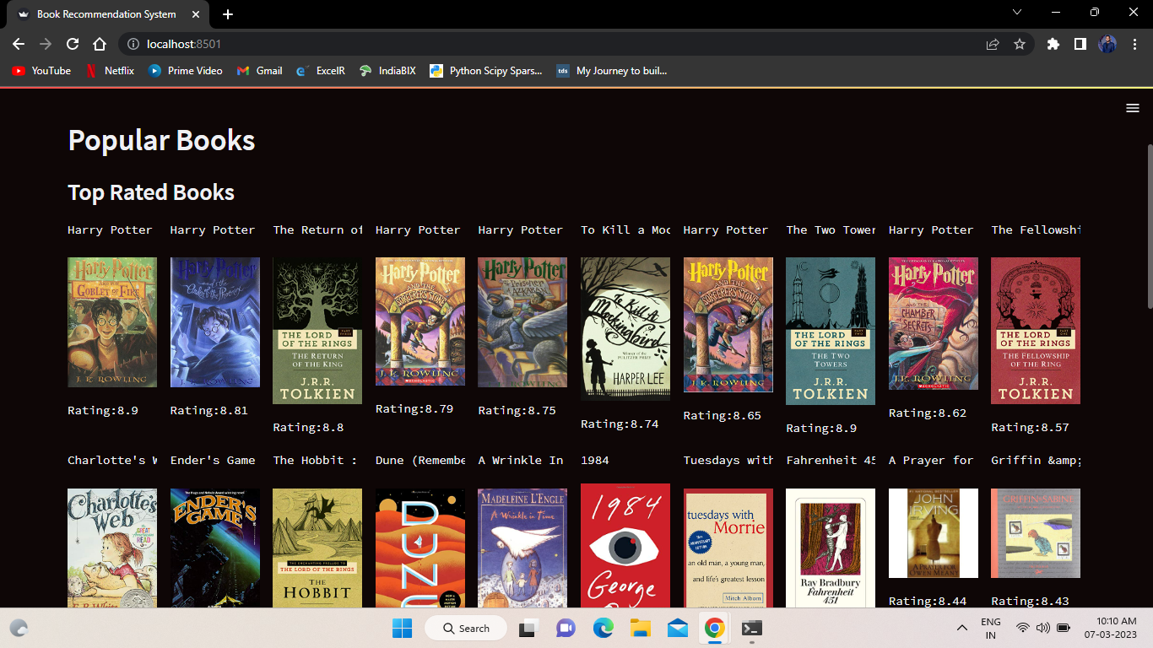
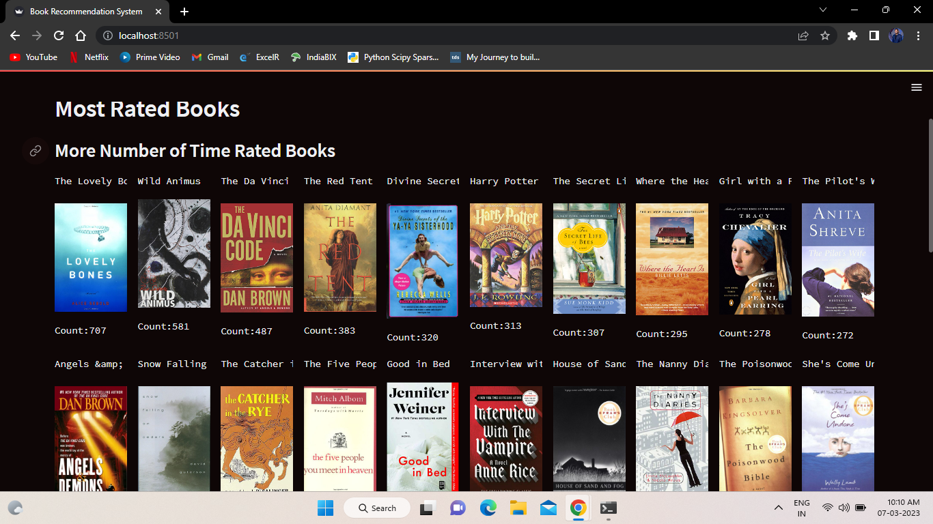
Top Rated Books & Most Rated Books

Slide 10
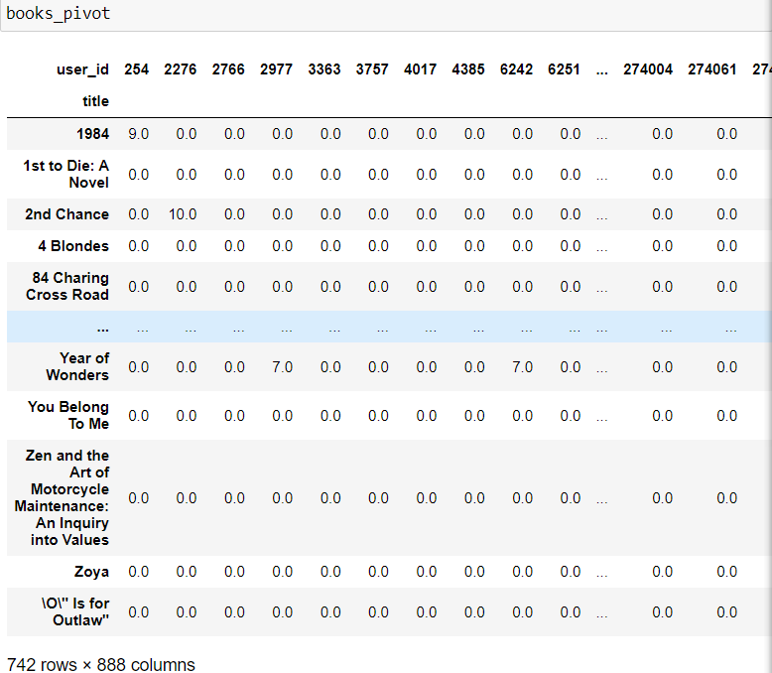
Collaborative Filtering Based Recommendation System:
To perform collabrative filtering we have created final dataframe by merging ratings and books Dataset,and converted into pivot_table where
(columns='user_id', index='title',
values='rating')and filled NaN values with 0.

Slide 11
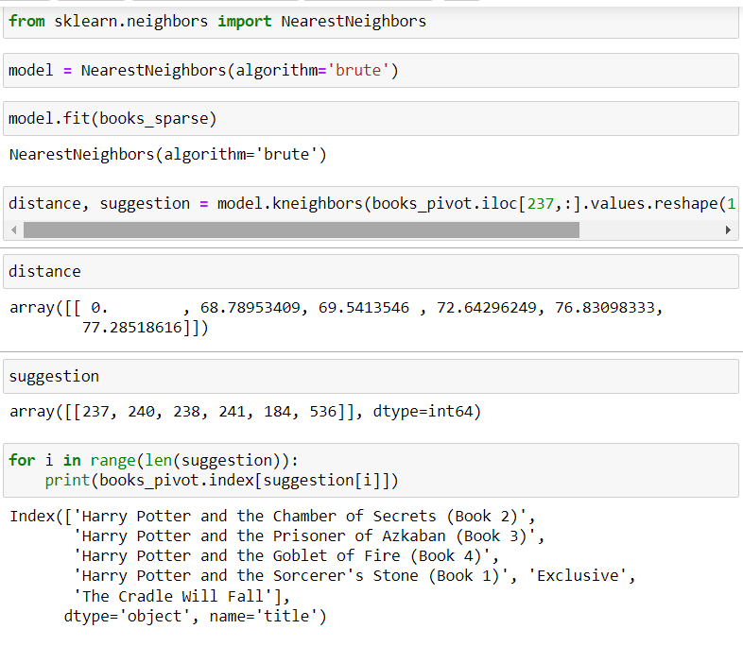
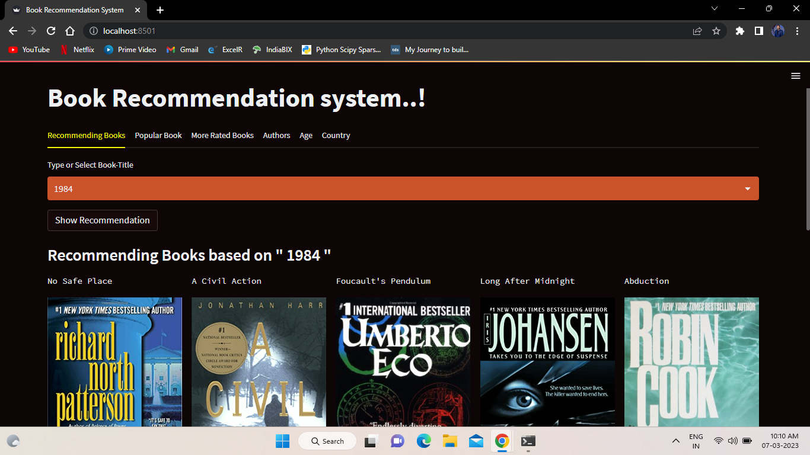
Book Name:
As pivot table as many 0 values we will use
csr_matrix that calculate only non-zero values
& does fast calculation.Then by using KNN we
will get Suggestions of Similar Book Names
There are two common types of matrices: sparse and dense. In difference to dense matrices, which have a majority of non-zero elements, sparse matrices have a majority of zeros.
When a large matrix is available, it is typical for the majority of the elements to be zeros. Therefore, makes it reasonable to conduct operations using only non-zero numbers because zero times anything always results in zero.

Slide 12
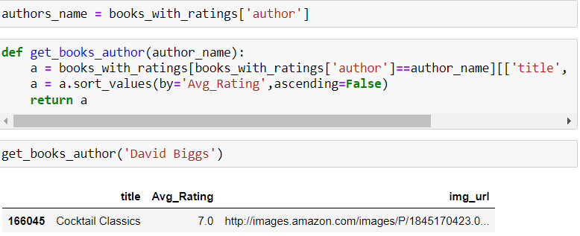
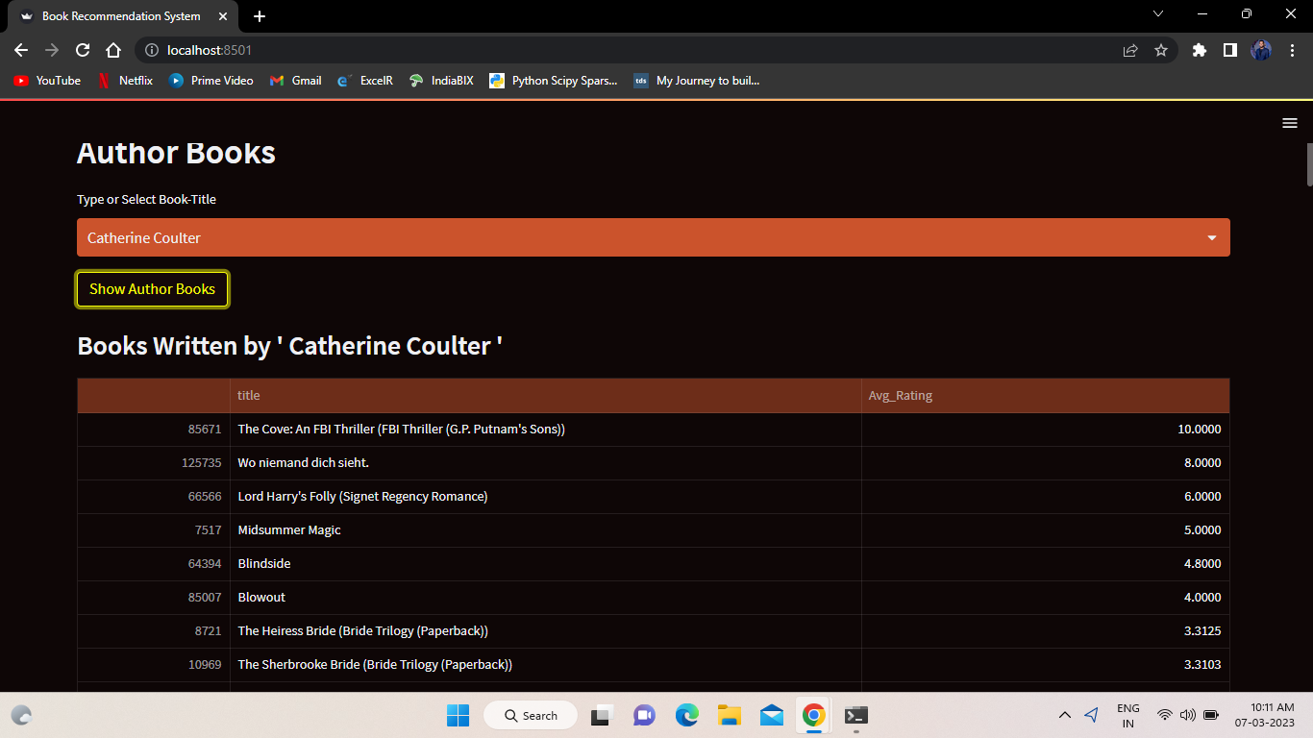
Author Name
To Get the recommendation by giving Name of author we used Books & Ratings Dataset

Slide 13
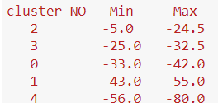
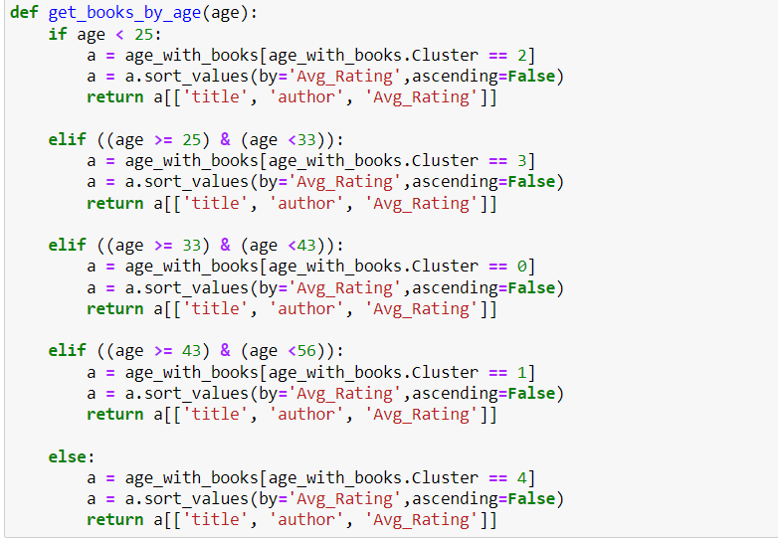
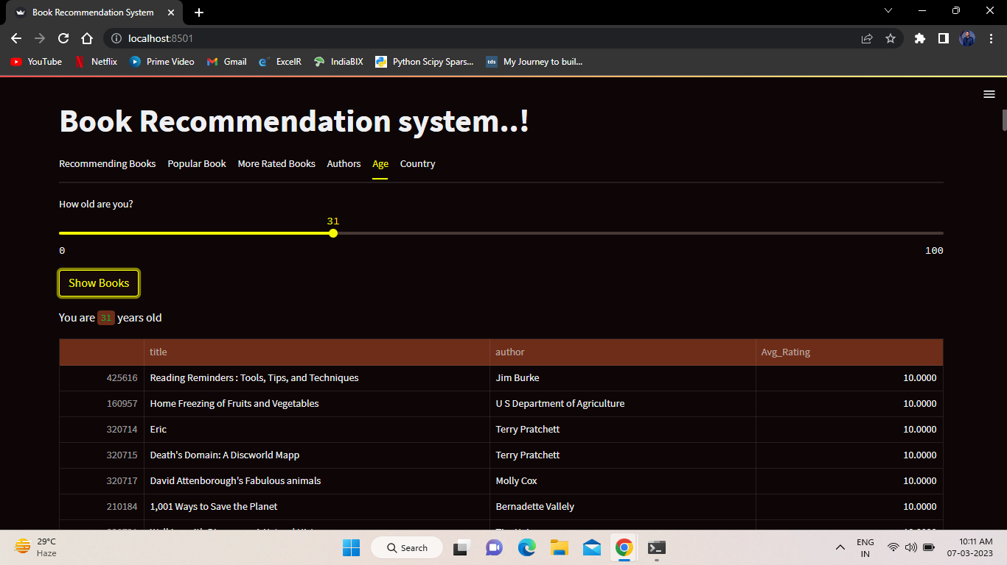
Age
To get Recommendation According to Age we have used Clustering & KNN.
and we got 5 clusters :
Then we gave age groupd for those clusters

Slide 14
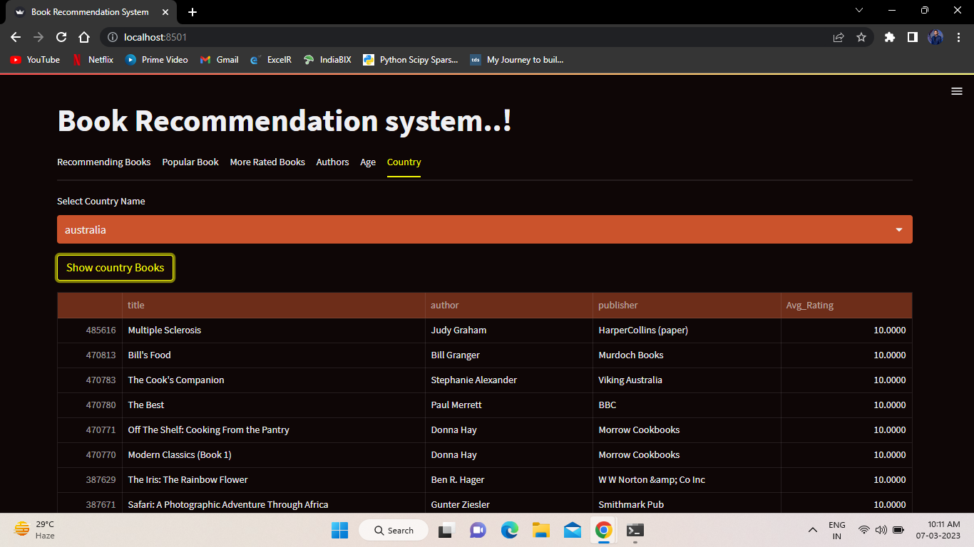
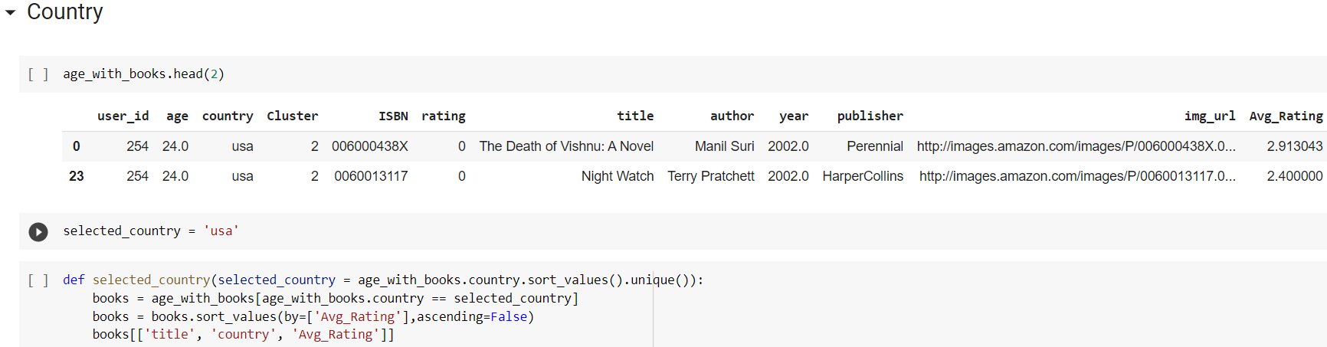
Country
To get Recommendation Based on Country Name we have merged Books & Users Dataset.

Slide 15
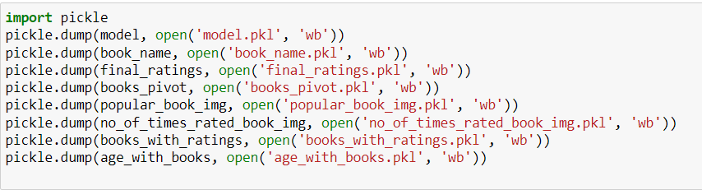
Deployement:
For Deployement we have used pickel files:
Home Screen

